Slide 1


Slide 2
By the end of today…
Understand our goals
Know and feel confident about your duties
Understand the LCC and be looking for people to help in it.

Slide 3
Goals of the Party
Teach and Promote Platform Values
Republican Candidates and Platform Values into law
Strengthen Neighborhood Voices
Unifying and developing methods to communicate and share ideas and perspectives

Slide 4
Platform
Agreed upon values of our priorities.
This is how we define what “conservative” means.
This is the criteria if a law is what is in our realm

Slide 5
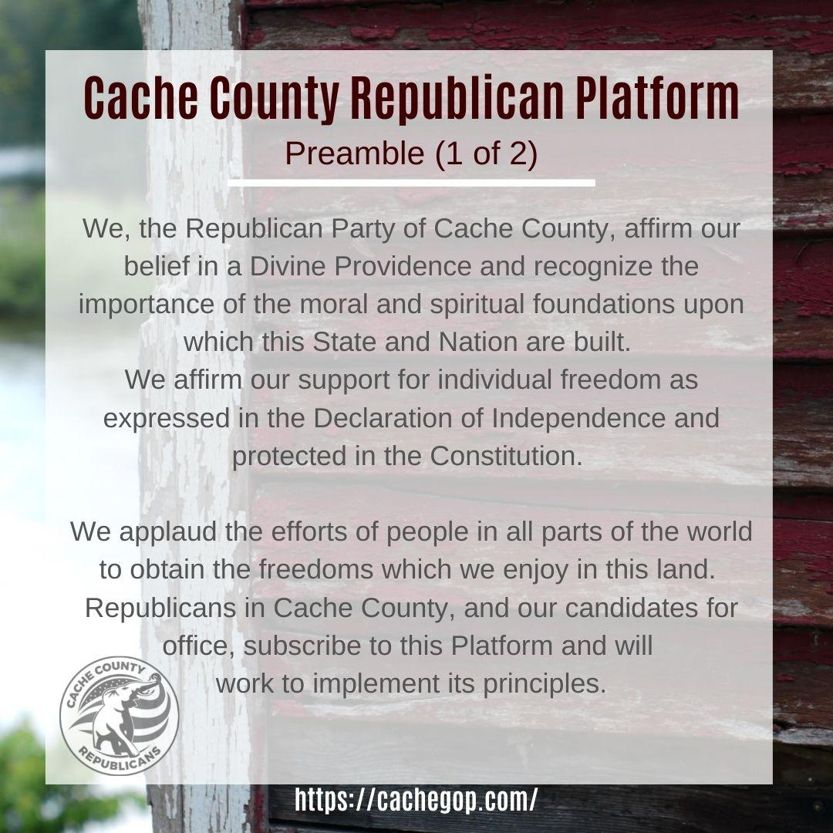

Slide 6
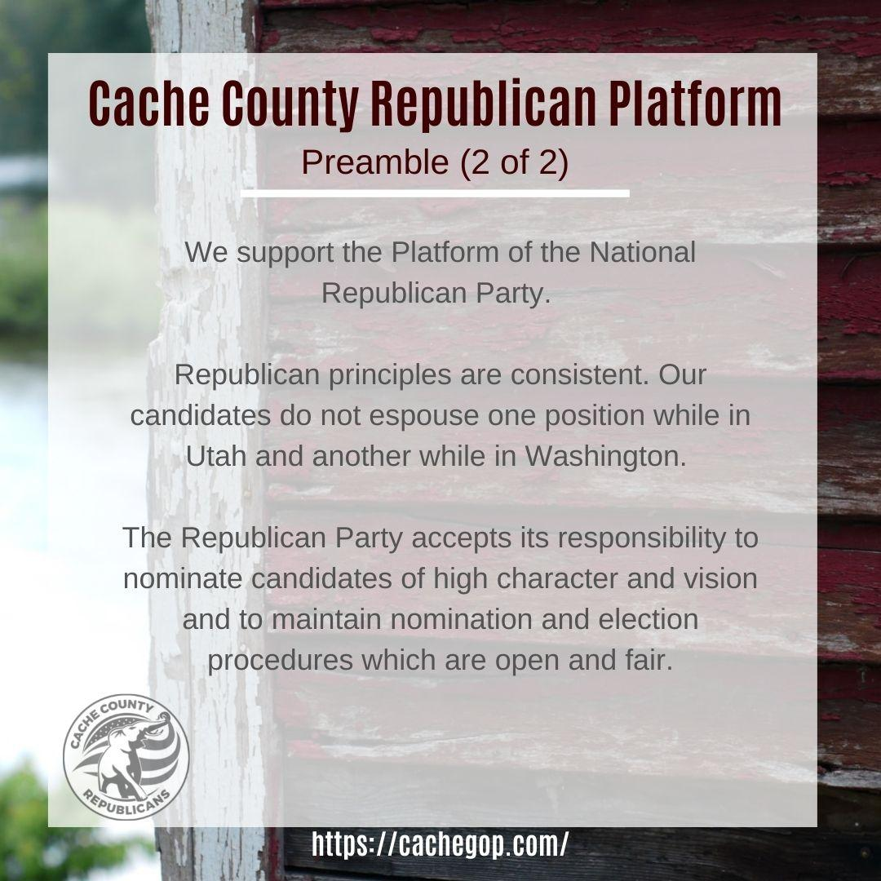

Slide 7


Slide 8


Slide 9


Slide 10
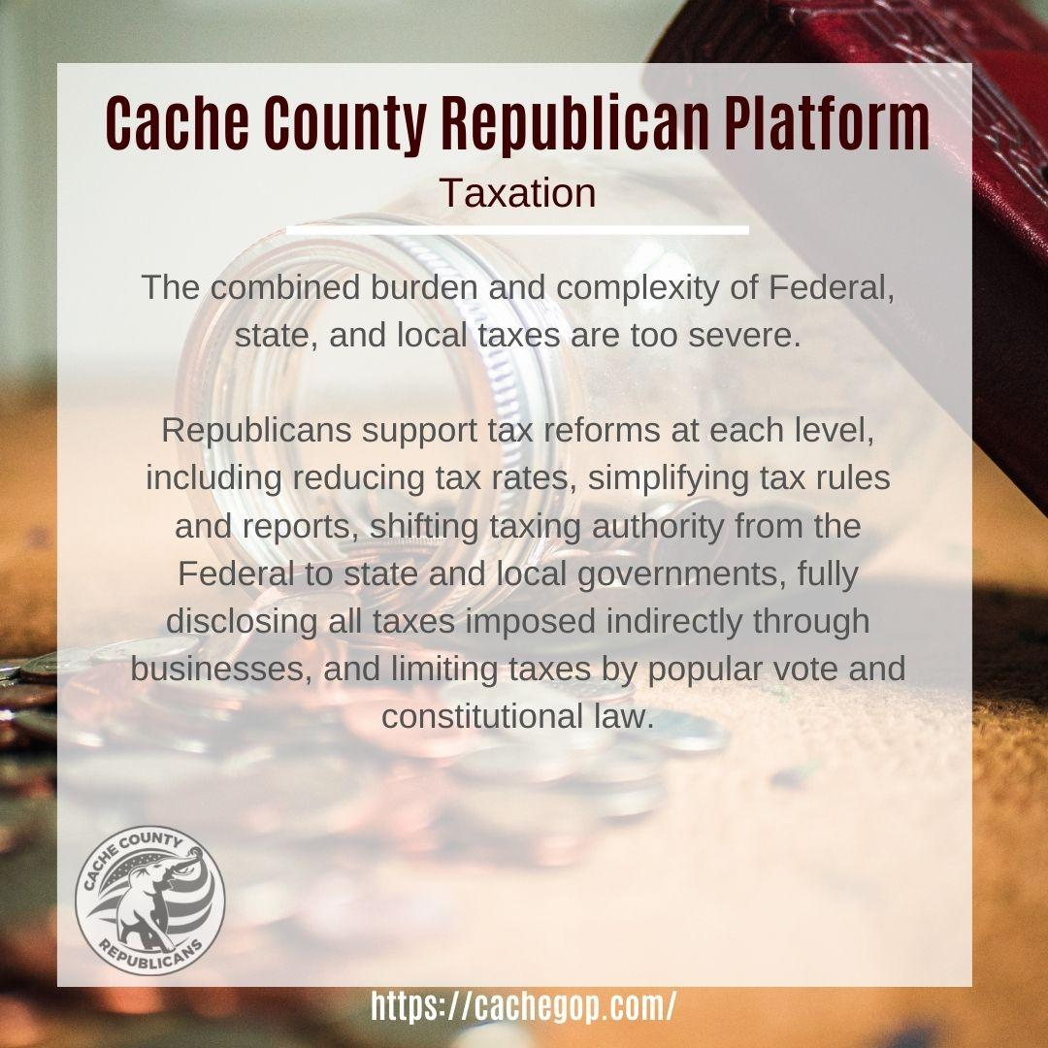

Slide 11
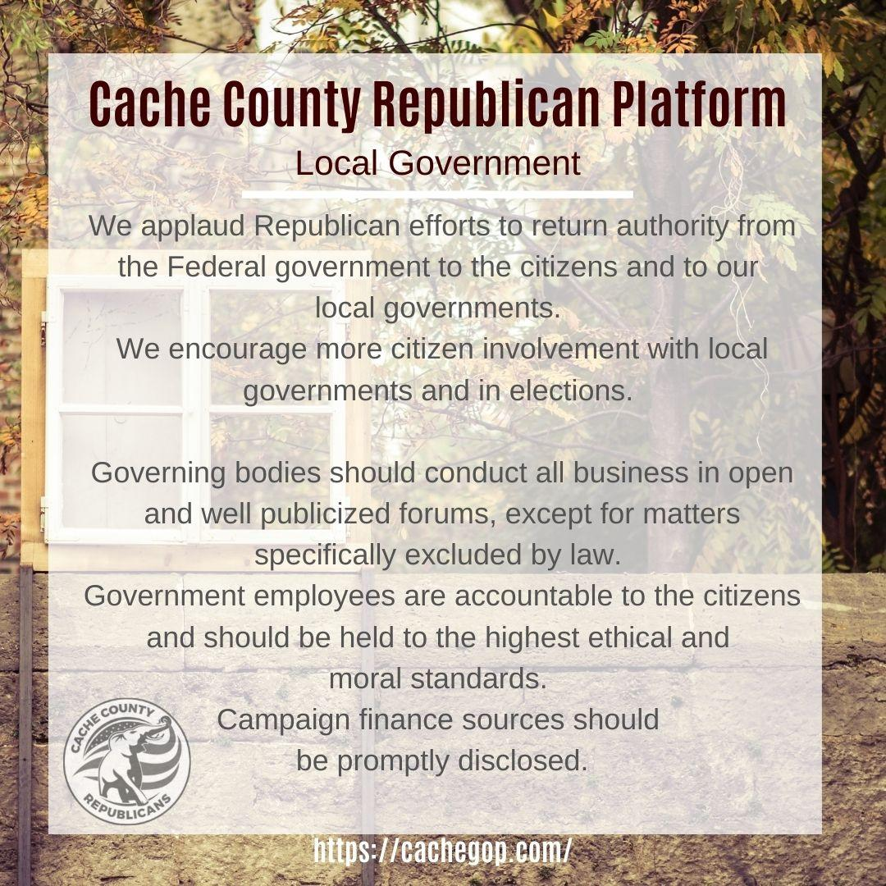

Slide 12
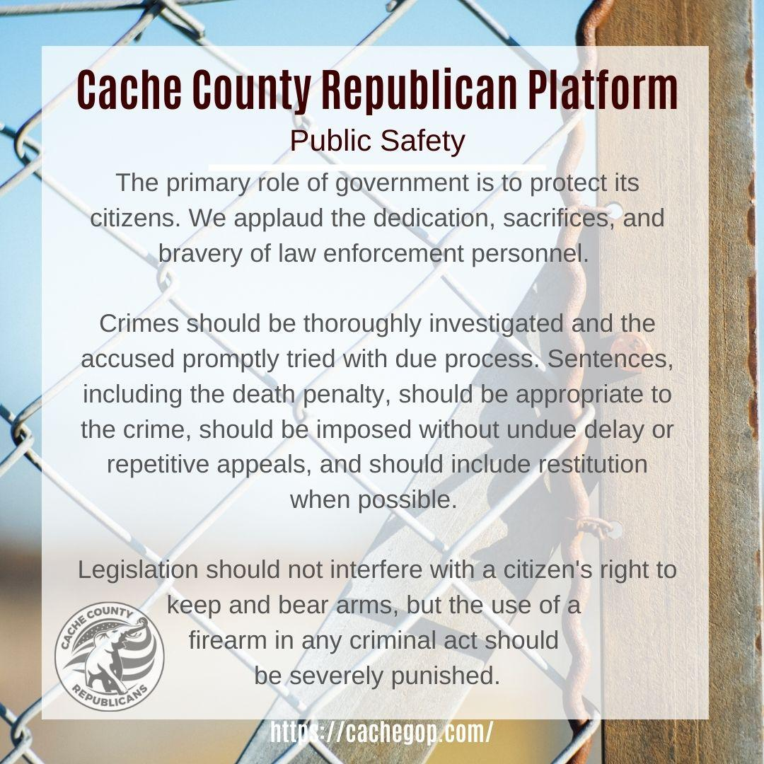

Slide 13
Precinct Duties
Distribute information and account for attendance for meetings
Distribute information and Promote and attend activities and Candidates/Representatives
Organize neighborhood groups to strengthen and support Party Goal
Welcome new members
Represent the voice of your neighborhood

Slide 14
Precinct Chair
Roles:
Leader of the party in the precinct
Member of the County Central Committee, Article 1
ex officio County Delegate at Nominating Convention, 6B5
2 Year Term

Slide 15
Precinct Chair
Responsibilities: 3 Parts
Party Business:
Attend conventions and special elections
Ensure precinct delegates attend conventions & special elections
Inform officers and delegates of meetings
Coordinate alternate delegates where regular delegates cannot attend, 8A, 8B, 8C
Attend County Central Committee Meetings
twice each year, Article 1

Slide 16
Precinct Chair
Precinct Organization:
Organize and lead party initiatives and efforts in the precinct
Post party events on social media
Recruit new members of the party within the precinct
Organize precinct voter registration efforts
Communicate with precinct members and delegates
Help general election candidates by knocking on doors, delivering door hangers, phone calls, etc.
Organize precinct members to help candidates

Slide 17
Precinct Chair
Caucus:
Coordinate caucus meeting locations with County District Chairs and party officers
Post notice of caucus meeting locations
Plan and run the next Neighborhood Caucus Night, 6B1

Slide 18
Precinct Chair
Votes on:
Party office positions:
  Primary candidates for elected office at Nominating Convention, 6B5
  County Party Leaders at Organizing Convention, 3A
  State Central Committee Members at Organizing Convention, 6B5
  District Chair Positions at Organizing Convention, 6B5
  Special Elections for certain officials, 8H2
Bylaw updates , 6B5
Platform updates, 6B5

Slide 19
Precinct Vice-Chair
Roles:
Act as chair in the absence of the Precinct Chair
Assist chair in running the precinct, including all Chair responsibilities listed above
Member of County Central Committee, Article 1
Responsibilities:
2 Year Term
Represent precinct at conventions and special elections
Assist in the next Neighborhood Caucus Night
Attend County Central Committee Meetings twice each year, Article 1
Attend and vote in special elections
Assist with initiatives and efforts in the precinct

Slide 20
Precinct Vice-Chair
Votes on:
Party office positions:
  County Party Leaders Organizing Convention, 3A, 6B5
  State Central Committee Members Organizing Convention, 6B5
  District Chair Positions Organizing Convention, 6B5
  Special Elections for certain officials, 8H2
Bylaw updates at Organizing Convention, 6B5
Platform updates at Organizing Convention, 6B5

Slide 21
Precinct Secretary
Roles:
Member of County Central Committee, Article 1
Responsibilities:
2 Year Term
Represent precinct at conventions and special elections
Assist in the next Neighborhood Caucus Night
Attend County Central Committee Meetings twice each year, Article 1
Attend and vote in special elections
Assist the Precinct Chair in initiatives and efforts in the precinct, see responsibilities listed above
Maintain precinct membership records and positions
Track and ensure all contact data is current

Slide 22
Precinct Secretary
Votes on:
Party office positions:
  County Party Leaders Organizing Convention, 3A, 6B5
  State Central Committee Members Organizing Convention, 6B5
  District Chair Positions Organizing Convention, 6B5
  Special Elections for certain officials, 8H2
Bylaw updates at Organizing Convention, 6B5
Platform updates at Organizing Convention, 6B5

Slide 23
Precinct Treasurer
Roles:
Member of County Central Committee, Article 1
Responsibilities:
2 Year Term
Represent precinct at conventions and special elections
Assist in the next Neighborhood Caucus Night
Attend County Central Committee Meetings twice each year, Article 1
Attend and vote in special elections
Assist the Precinct Chair in initiatives and efforts in the precinct, see responsibilities listed above
Maintain precinct membership records and positions
Track and ensure all contact data is current

Slide 24
Precinct Treasurer
Votes on:
Party office positions:
  County Party Leaders Organizing Convention, 3A, 6B5
  State Central Committee Members Organizing Convention, 6B5
  District Chair Positions Organizing Convention, 6B5
  Special Elections for certain officials, 8H2
Bylaw updates at Organizing Convention, 6B5
Platform updates at Organizing Convention, 6B5

Slide 25
State Delegate
Roles:
Member of State Party Nominating Convention
Responsibilities:
Review and vet candidates for public office (listed below) according to the party’s principles as found in the State Party Platform and County Party Platform
Review and vet candidates for party positions (listed below)
Review and consider amendments to State Party Constitution, Bylaws and Platform
Attend annual State Party Convention (Nominating, then Organizing)

Slide 26
State Delegate
Votes on:
Public Office Races:
  US Senate
  US House of Representatives
  State Governor & Lt. Governor
  State Attorney General
  State Auditor
  State Treasurer
  State School Board
  State Senators (multi-county districts)
  State Representatives (multi-county districts)
Party Positions:
  State Party Leaders at Nominating Convention
  National Committeeman & National Committeewoman
  Utah Delegates to the National Republican Convention
  Utah Electors for the Electoral College

Slide 27
County Delegate
Roles:
Member of County Party Nominating Convention
Responsibilities:
Review and vet candidates for public office (listed below) according to the party’s principles as found in the State Party Platform and County Party Platform
Review and vet candidates for party positions (listed below)
Review and consider amendments to County Party Constitution, Bylaws and Platform
Attend annual County Party Conventions (Nominating, then Organizing)
Attend and vote in special elections

Slide 28
County Delegate
Votes on:
Public Office Races:
  County Council Members
  County Attorney
  County Clerk
  County Auditor
  County Sheriff
  County Assessor
  County Surveyor
  County Treasurer
  County Recorder
  State School Board
  State Senators (single county districts)
  State Representatives (single county districts)
  Special Elections for certain officials 8H2
Party Positions:
  County Party Leaders at Organizing Convention, 3A
  State Central Committee Members

Slide 29
State Central Committee Member
Roles:
Member of State Central Committee
Responsibilities:
Attend quarterly State Central Committee Meetings
Review and consider amendments to State Party Constitution, Bylaws and Platform
Votes on:
Amendments to State Party Constitution, Bylaws and Platform

Slide 30
Precinct Duties
Distribute information and account for attendance for meetings
Distribute information and Promote and attend activities and Candidates/Representatives
Organize neighborhood groups to strengthen and support Party Goal
Welcome new members
Represent the voice of your neighborhood

Slide 31

Communication is key!
What best works for you and your precinct?

Slide 32
Chris Olsen-
Cache Secretary
Leadership and Membership Information

Slide 33
LCC Training Videos
Presented by Christi Henshaw

Slide 34


LEGISLATIVE
COLLABORATION
COMMITTEES
WHAT CAN OUR LEGISLATIVE COLLABORATION COMMITTEES DO?
HOW DOES THE PROCESS WORK?

Slide 35
A PARTY IS A GROUP OF PEOPLE WHO SHARE COMMON VALUES AND VIEWS.
WE EXIST TO GET OUR PLATFORM (THESE VALUES) INTO LAW.

Slide 36
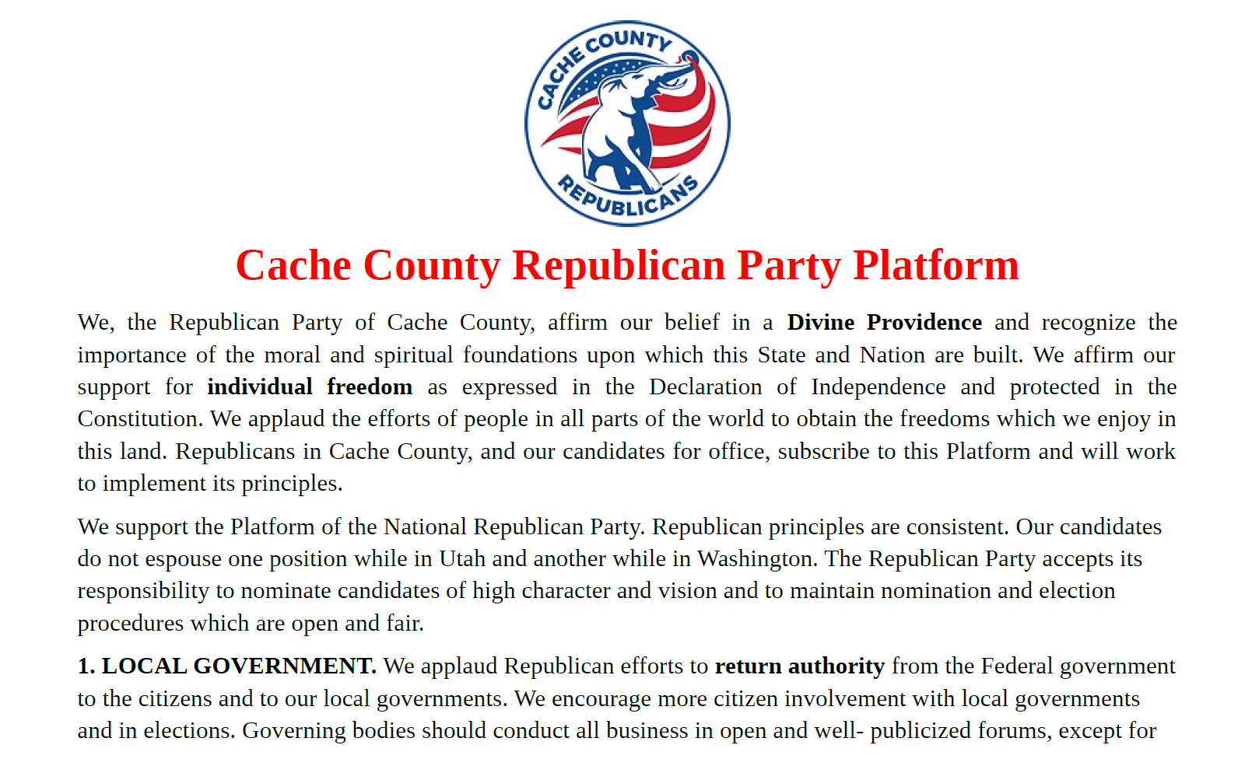

Slide 37

Teach a Cache County Republican to fish…

Slide 38
Well-Known Bills Can Be Subject to: Rumors, Lies, Hyperbole, Sold as Good, but really… Started Out Good, but now… To any of this, I hope your response after today is, “Well, Did You Read It?”
Does it really say that? Go look.
Condemnation without examination is the epitome of ignorance.
“The American People don’t read.” - Allen Dulles

Slide 39
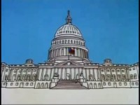
What is the basic legislative process?

Slide 40


How bills and laws are made:
THE IDEA FOR A BILL CAN COME FROM ANYONE – INCLUDING YOU!
HOWEVER, ONLY MEMBERS OF THE LEGISLATURE CAN INTRODUCE BILLS. THE SENATOR OR REPRESENTATIVE WHO INTRODUCES THE BILL BECOMES THE BILL’S SPONSOR
This Photo by Unknown Author is licensed under CC BY-SA

Slide 41
You can sometimes figure out how the bill came to be by asking who asked for the bill file to be opened and examine the bill using the latin phrase: Cui Bono?
Meaning: Who benefits? Who stands to gain from it; and thereby might be responsible for it? It’s the political motive question.

Slide 42

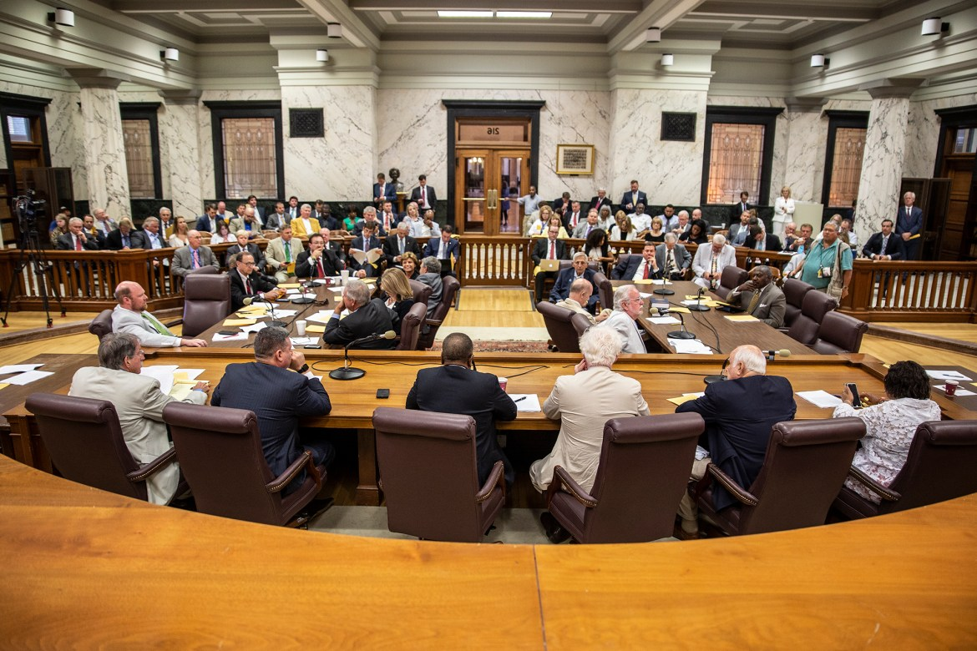
House bills originate in the House of Representatives; Senate bills originate in the Senate.
After being introduced, a clerk assigns each bill a number.
After being read on the floor of either the House or the Senate, the bill is then sent to a committee that specializes in its area of legislation (for example, the transportation committee).

Slide 43
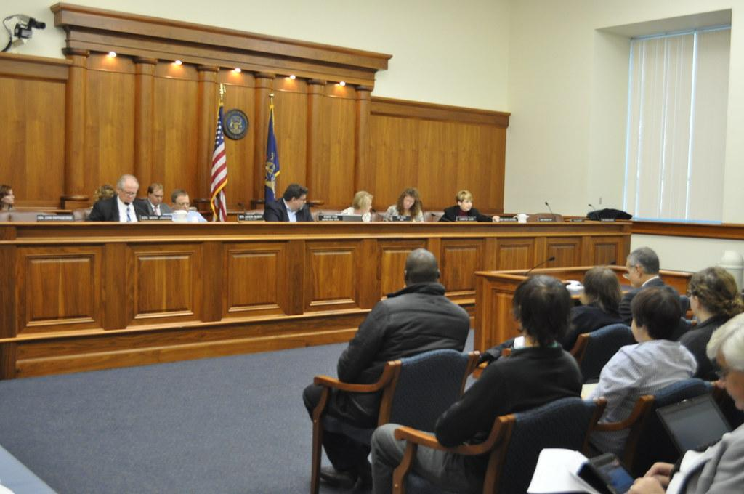
The Rules Committee assigns the bill to a Standing Committee
The committee debates the bill and may make changes to it, as needed.
Experts may be invited to testify.
Citizens can speak to the bill, as well.
The committee then votes to accept or reject the bill, or they may table the bill which stops its action.
If the bill passes the committee, it will be sent to the Floor of the House or the Senate.

Slide 44
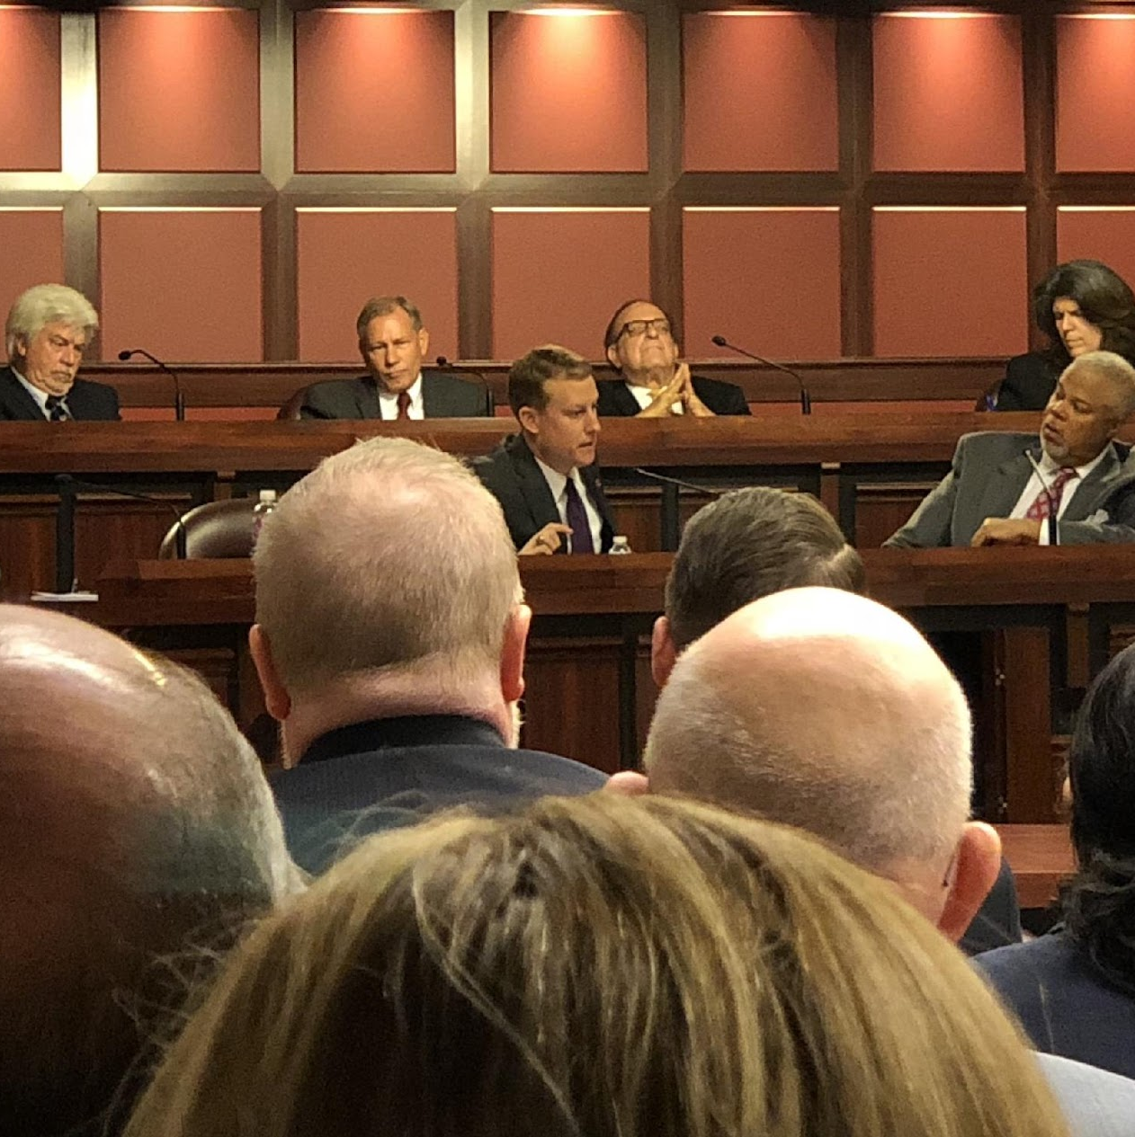
Show support or opposition
ATTEND COMMITTEE MEETINGS–IN PERSON OR ONLINE–WHEN AN IMPORTANT BILL IS BEING HEARD.
SOMETIMES THERE’S ONLY 24 HOURS NOTICE.

Slide 45
Decorum:
behavior in keeping with good taste and propriety
Speak and direct all comments to the Chair
Thank the Chair and Committee
Helpful to use the word, “Respectfully”
Don’t go over time
Suggestion: Ethos, Pathos, Logos: Read the room and have all 3 ready

Slide 46
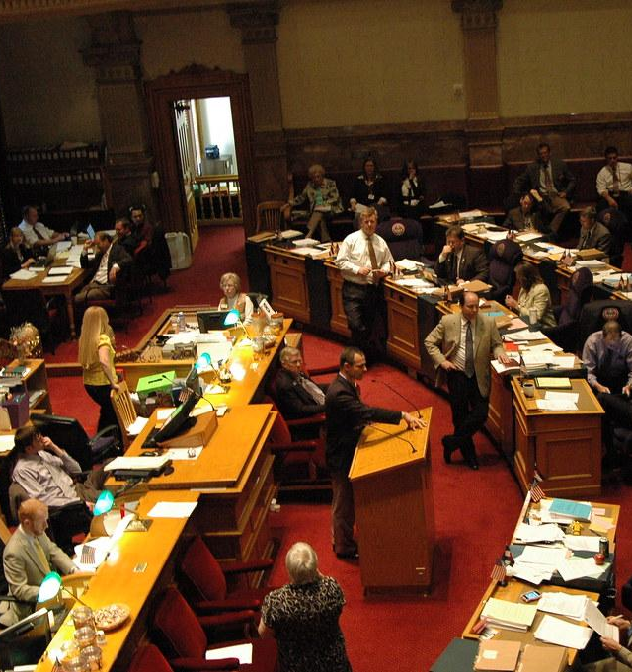
On the Floor…
MEMBERS OF THE LEGISLATURE DEBATE THE BILL
AMENDMENTS MAY BE OFFERED
THEN A VOTE IS TAKEN WITH MEMBERS OF THE ENTIRE CHAMBER
IF THE MAJORITY VOTES IN FAVOR OF THE BILL…

Slide 47
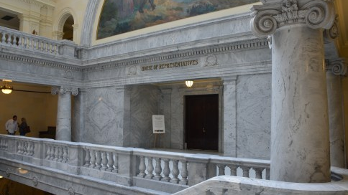
The Bill Passes that Chamber!
IT IS THEN SENT TO THE OTHER CHAMBER (HOUSE OR SENATE) AND THE PROCESS STARTS ALL OVER AGAIN!

Slide 48

Write Emails – Make Phone Calls
  Whenever there is a bill coming through that needs special attention, take a moment to send your legislator a message of either support or opposition. They don’t know what their constituents want unless we tell them.

Slide 49
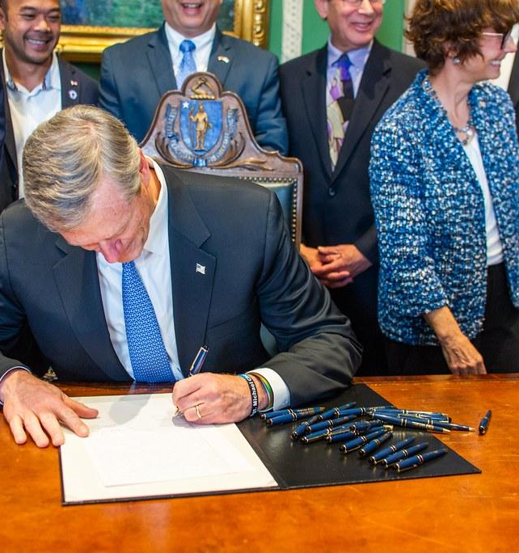
In the other chamber, the bill goes through another committee hearing, then onto a vote on the floor.
If it passes all of that, then it goes to the Governor for a signature.

Slide 50

Then we have a LAW!

Slide 51
https://le.utah.gov
How to Navigate the Website:
Overview
Calendar
Bills by Session
Bills by Legislator
Code by Subject
Amendments
Where to Find Votes

Slide 52
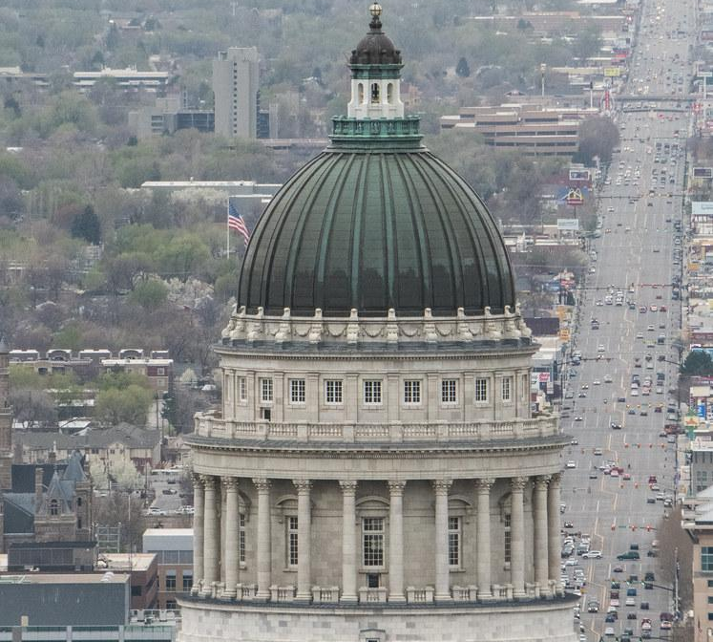
L.C.C.’s
Legislative Collaboration Committees
Follow the Committees and Sponsored Bills of Your:
House Representative
Senator
County Commission (training later)
You’ll Need:
A Lead (Your House Chair, HVC, or HEO)
A communication thread with your LCC and your rep. or sen.
A device, some time, potential travel, willingness to learn, and an appreciation for representative government

Slide 53
LCC Rules:
Legislative Collaboration Committees
Not a soapbox
You will lose… move on…try again
Ask specific questions
Bring specifics solutions (line by line)
Stick to principles/Connect to the platform
Do not harangue
Pre-browse their committee bills and sponsored bills
Removal: You can be removed
Remember they’re human: It’s rough. You’ll have more compassion. You are on the same team.

Slide 54
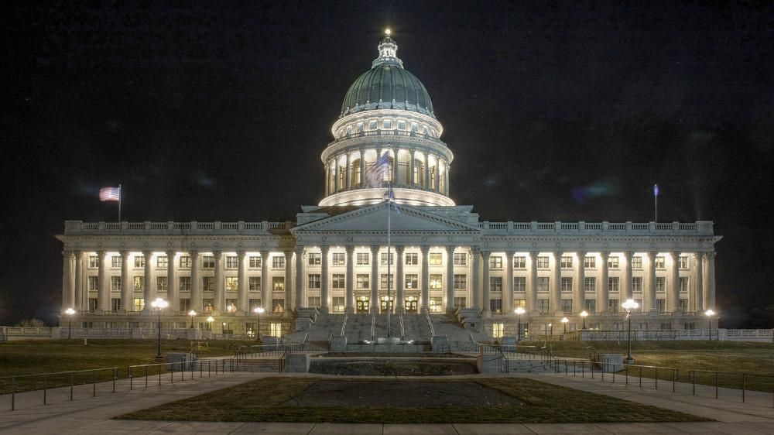
January 21st – March 7th, 2025
(seven weeks/45 days,
minus fed. holidays)
EVERY Person and every L.C.C. can make a difference!
Legislative Collaboration Committees

Slide 55
How to “Win” All the Time:
Relationships
Bring Solutions
Be Patient
Know When to Get People There & When to Lay Low
Collaborate
Work Together Sometimes & Against Sometimes, but try to preserve the relationship
Be Prepared with Good Questions: Who Decides? What’s the Data? Compared to What?

Slide 56
Advice for Legislators:
Strong and kind are not mutually exclusive.
Abilene Effect: Ask them to play the devil’s advocate or the 10th man.
Problem/Reaction/Solution: Outlier or Protected Class as the foot in the door, nose in the tent.
If you don’t know, vote NO!
Golden Handcuffs: Whatever is done to us, is done to you. We’re all in this together!

Slide 57
Don’t stop because sometimes we are placing stepping stones for our children.
“Duty is Ours, Results are God’s”
- John Quincy Adams

